Slide 1
Springboard – Capstone 3
Sidharth Ramanan

Slide 2
Context
Goal was to build a model that can classify Indian foods across 80 different classes
Used a dataset from Kaggle
Deep Learning project, so will be exploring image classification with CNNs

Slide 3
Dataset
4000 images
80 different types of Indian Foods, ranging from things like Chicken Tikka Masala to Rasogulla
50 images per class – balanced dataset

Slide 4
Data Wrangling
Used Kaggle API to download dataset onto Google Drive
Dataset already had images divided into subdirectories
Divided each subdirectory into train, validation, and test and put in new folders with those names

Slide 5
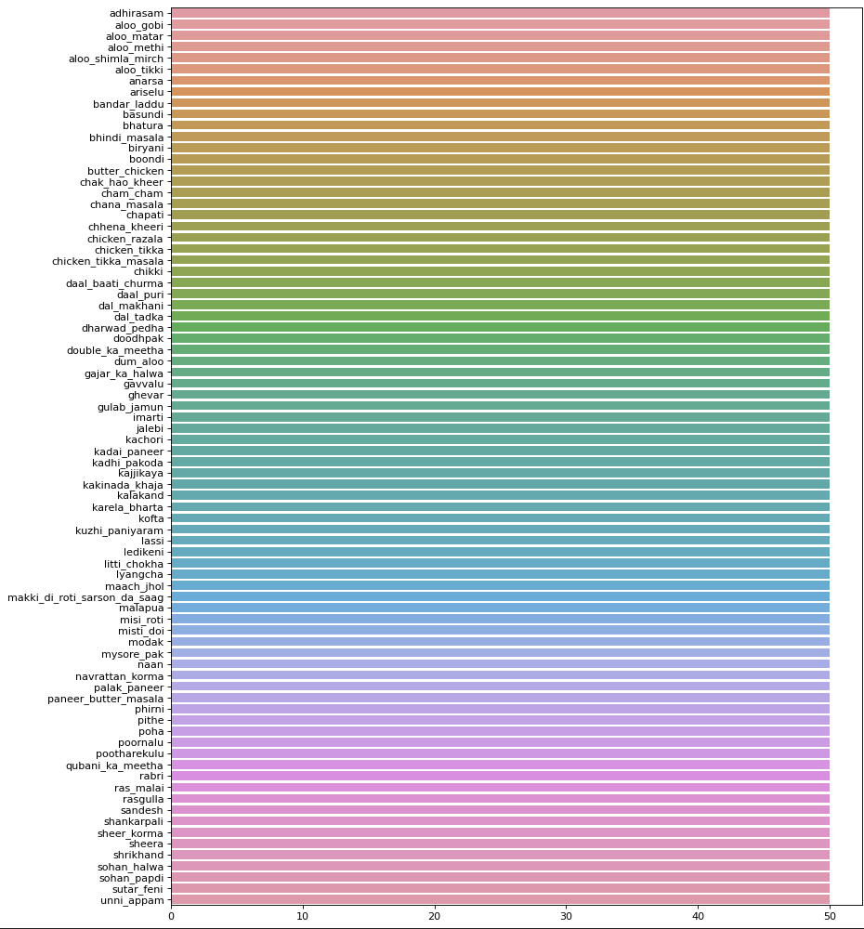
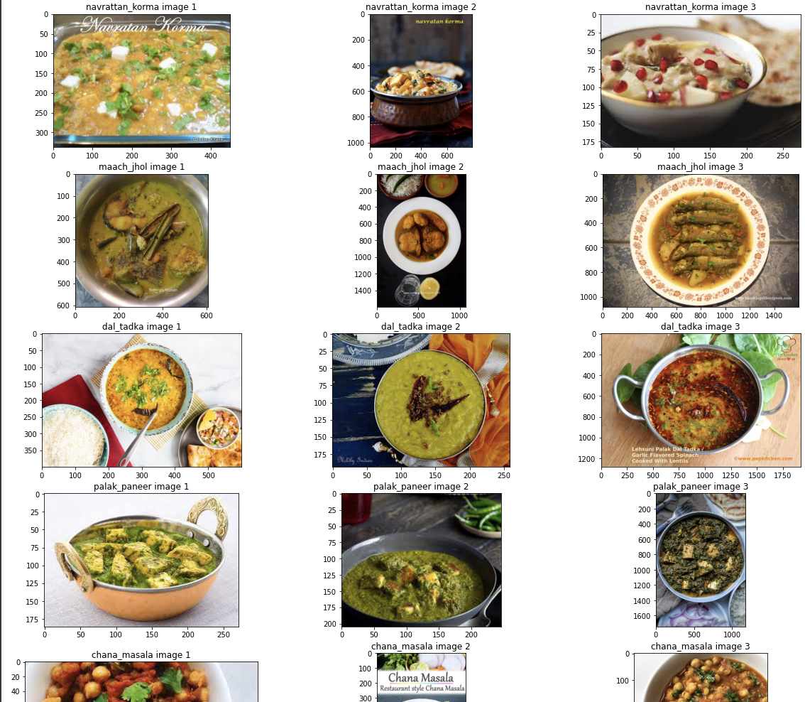
Exploratory Data Analysis
Verified that classes were balanced by building a bar chart
Randomly chose 5 classes and 3 images from each class to inspect

Slide 6
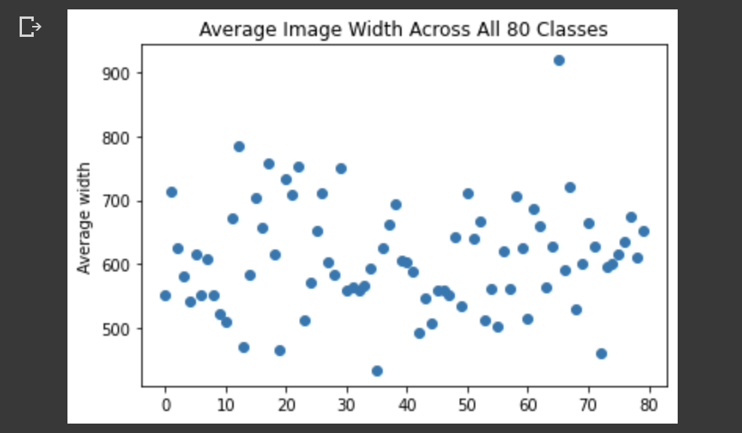
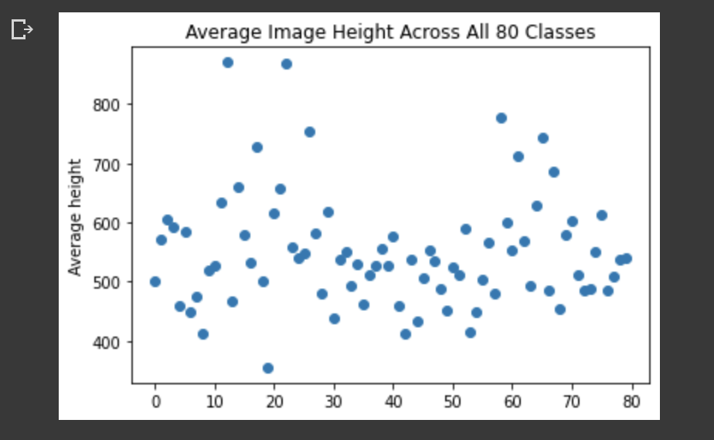
Exploratory Data Analysis
Some of the randomly selected images had text – potentially troublesome for model fitting
Inspected image resolutions in anticipation of building ImageDataGenerator with Keras

Slide 7
Modeling
Used well-established CNN architectures that performed well on ImageNet challenges
Transfer Learning with these base models by adding additional layers on top of them for training, but freezing all other learned weights
Decided to explore VGG-16, ResNet-50, AlexNet, and VGG-19

Slide 8
Modeling
Did not need to do any preprocessing since Keras ImageDataGenerator does image transformations like rotations, shearing, zooming, shuffling, etc during training
Tweaked parameters like target image size, number of nodes in each layer, dropout, number of fine-tuned layers, zoom/shear ranges, and number of epochs to train
Noticed VGG-16 performed best at first (~20% test accuracy) so decided to focus most efforts on improving it

Slide 9
Modeling
By increasing target size from (50, 50) to (240, 240), increasing shear/zoom ranges, and reducing the number of nodes in augmented layers (model was overfitting), was able to bring accuracy of VGG-16 to 50.3%!
Other models generally performed poorly, except for VGG-19 which gave test accuracies of around 35%
Best Model Stats:
Statistic | Value
Accuracy | 50.38%
Top-3 Prediction Accuracy | 71.88%
Precision | 0.571
Recall | 0.455
F1-Score | 0.506

Slide 10
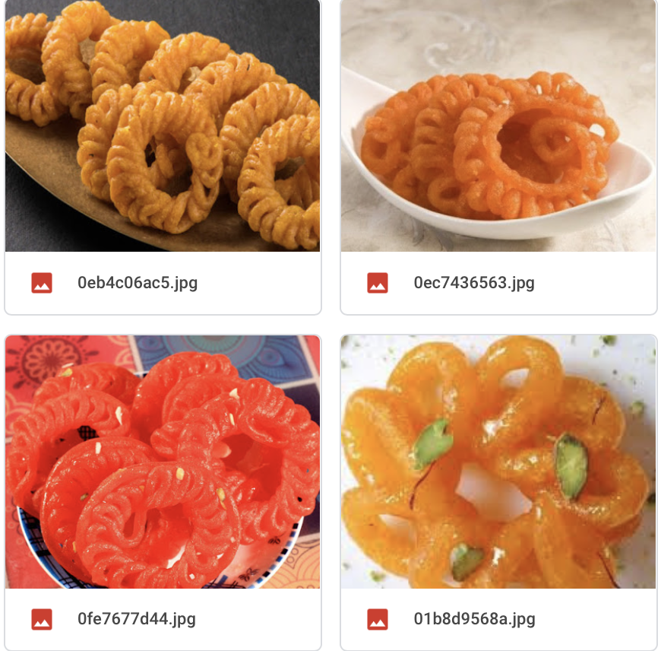
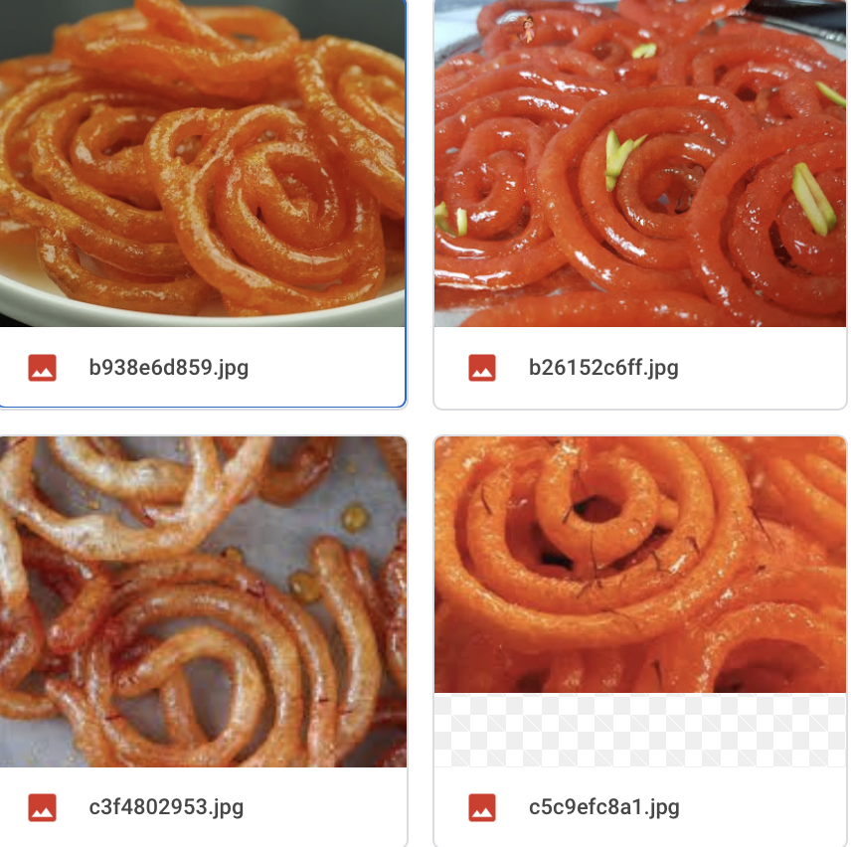
Modeling
Inspected best model’s predictions to look for interesting patterns
Noticed that best model made very reasonable mistakes, such as:
Mistaking chicken tikka with chicken tikka masala
Chapati with naan
Imarti with Jalebi
Aloo Shimla Mirch with other Aloo based dishes in the dataset
Imarti
Jalebi

Slide 11
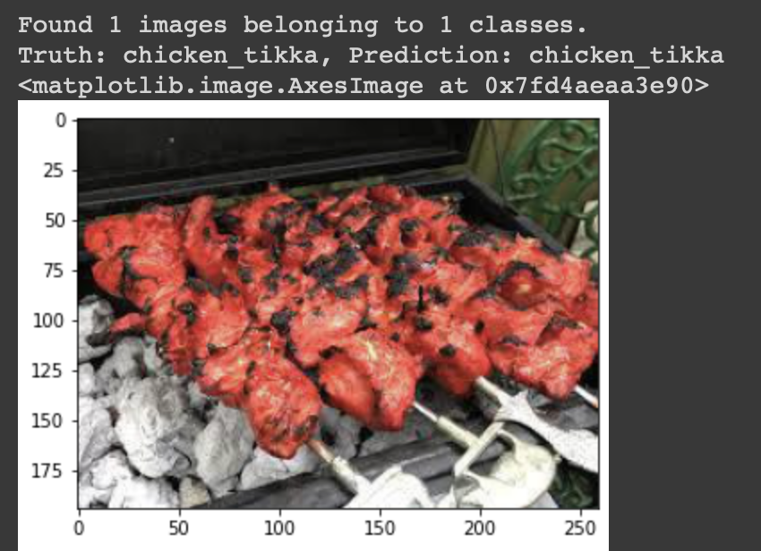
Modeling
Decided to make a pipeline for other images to be predicted by best model
Challenging because of inflexibilities of Keras models – needed to batch even a single image and store it in directory
Wrote code to randomly select image from test set (for now), render image, and make prediction on that image

Slide 12
Conclusion
Major takeaways:
Learned how to setup efficient workflow with Colab/Google Drive/Kaggle for Deep Learning projects
Understanding Tensorflow/Keras API better for NN building
Appreciating nuances/challenges of training neural networks
Appreciating preprocessing involved with image learning tasks – morphological, base model preprocessing, etc

Slide 13
Conclusion
50% + accuracy on dataset with 80 classes is a good milestone
Model was making reasonable mistakes, so that’s evidence that is was able to learn meaningful features
Hard to increase accuracy beyond this
Learning task was also challenging because Indian foods are rich both ingredient-wise and aesthetically – model needs to detect subtle and specific differences

Slide 14
Scope for improvement
More systematic parameter tuning with Keras Tuner to find better hyperparameter combinations
Other base model CNN architectures?
Gradient boosting with XGBoost?
Vision Transformers?

Slide 15
Thank You!

